Slide 1




The National Institute of Engineering
Department of Electrical and Electronics Engineering
Mananthavadi Road, Mysore-570008
EME PRESENTATION
on
HINDUJA GROUP
BY
MITHUN URS P - 4NI19EE058
MOHAMMAD ARSHAD - 4NI19EE059
RAVI N - 4NI19EE082
VARSHITHA A S - 4NI19EE116
Under the guidance of
Ms. Shwetha M M.Tech

Slide 2


Slide 3

Hinduja group strategically invests in multiple business and geographies through both stock and industrial investment.
The groups investment philosophy encompasses both short term minority holdings and long term strategic positions in constituent companies with majority holdings.
In its long term holdings, the group identifies appropriate business opportunities.
The group also undertake many philanthropic ventures.

Slide 4
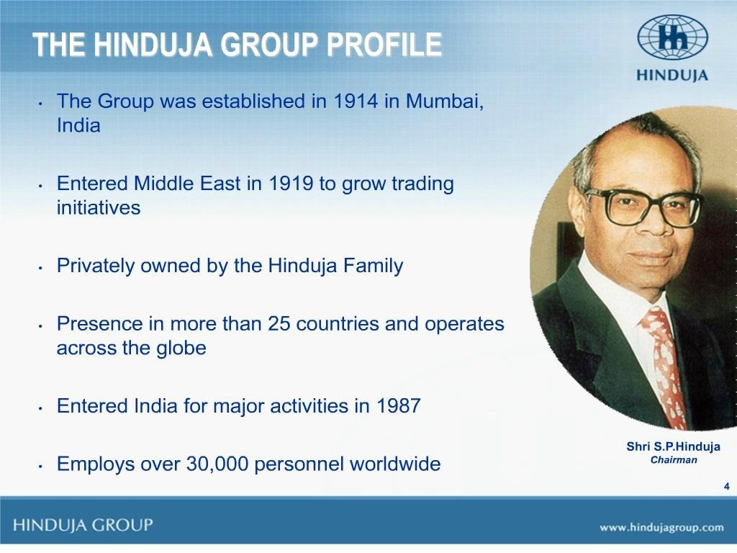

Slide 5
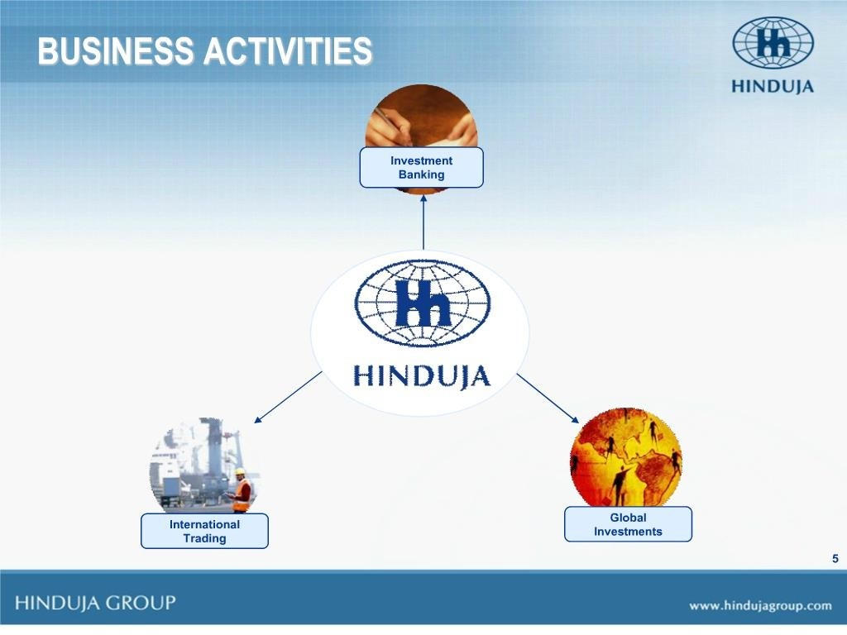

Slide 6
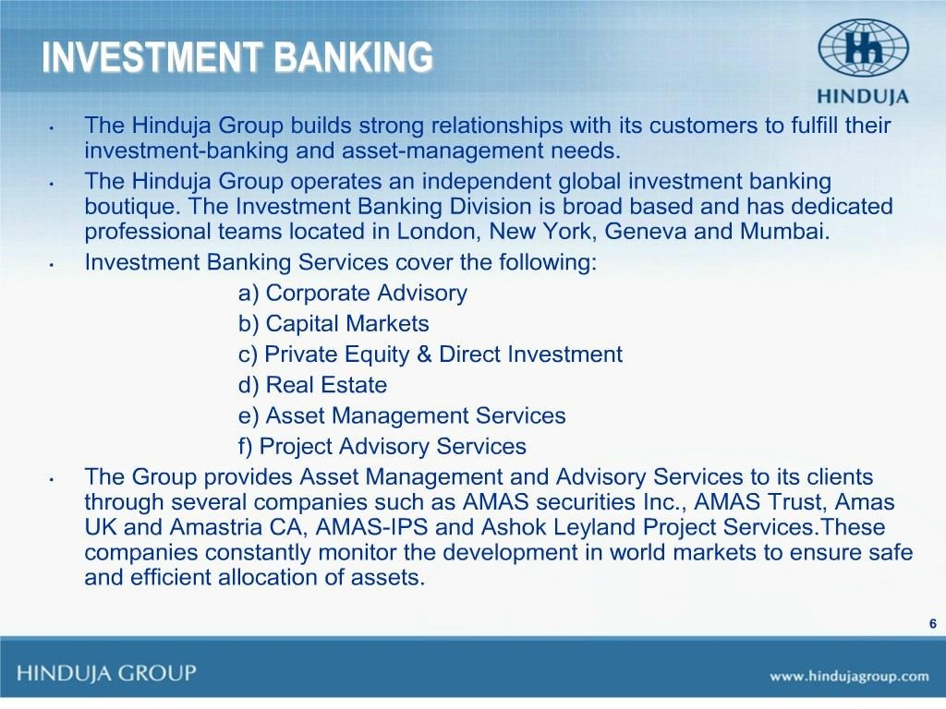

Slide 7
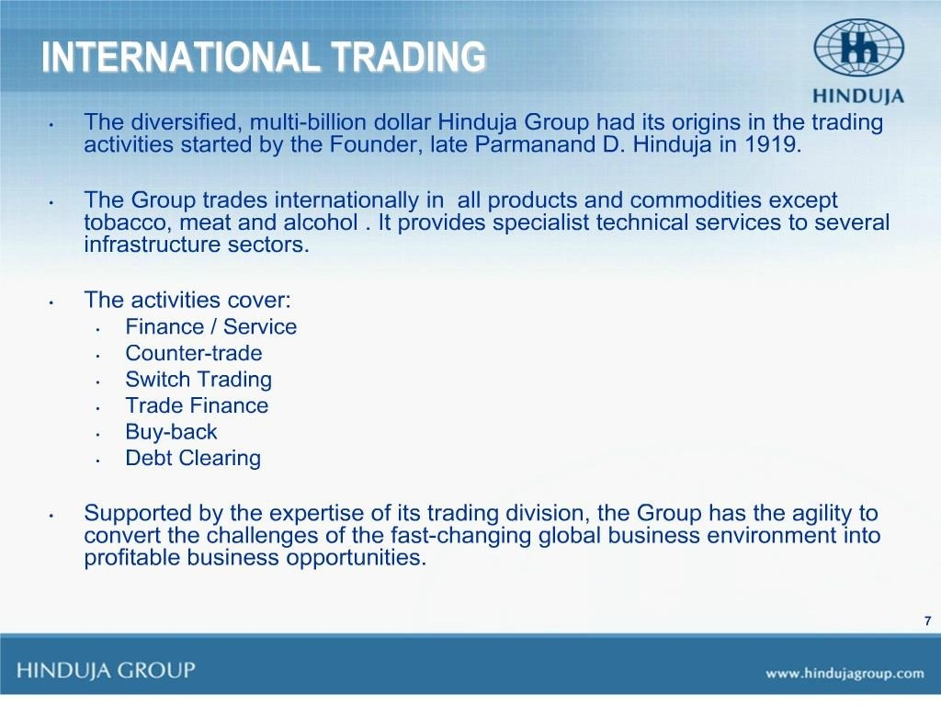

Slide 8
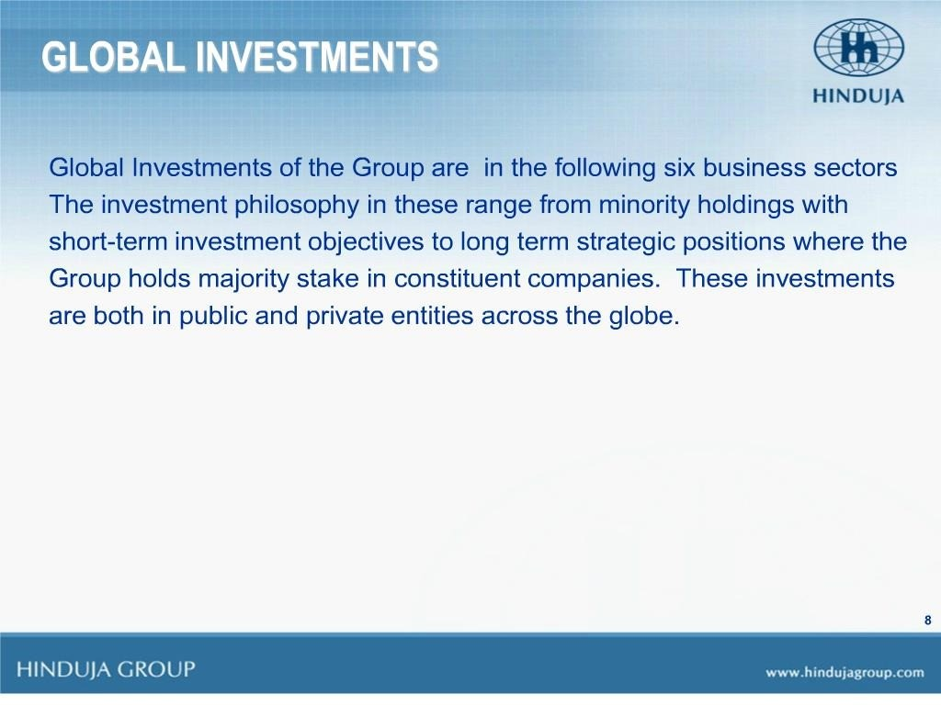

Slide 9
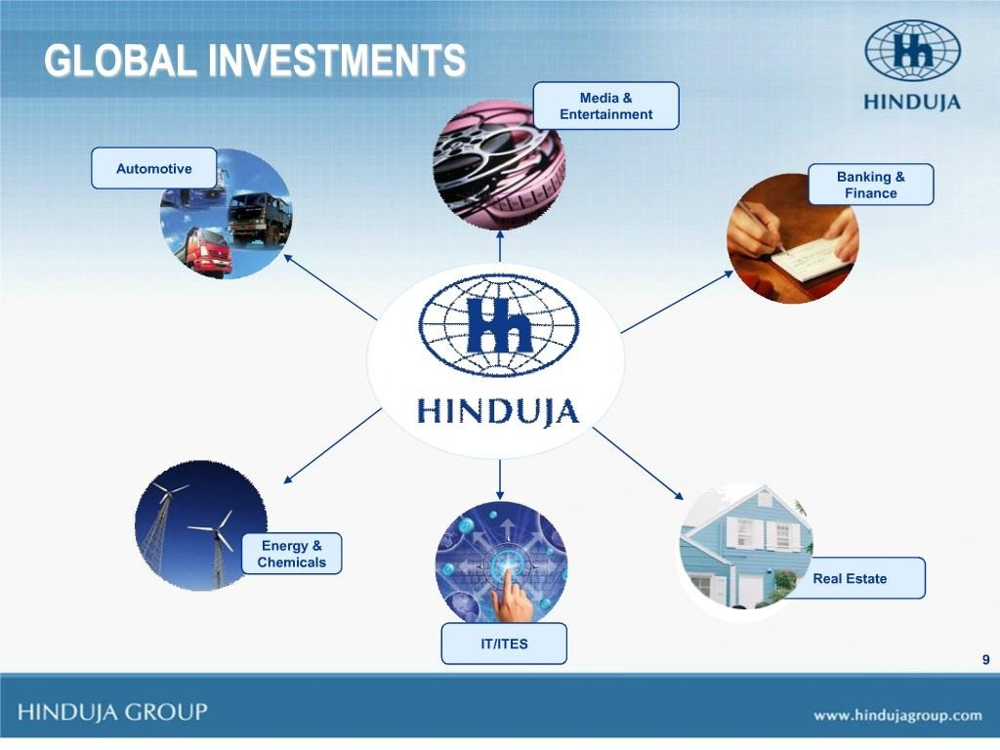

Slide 10
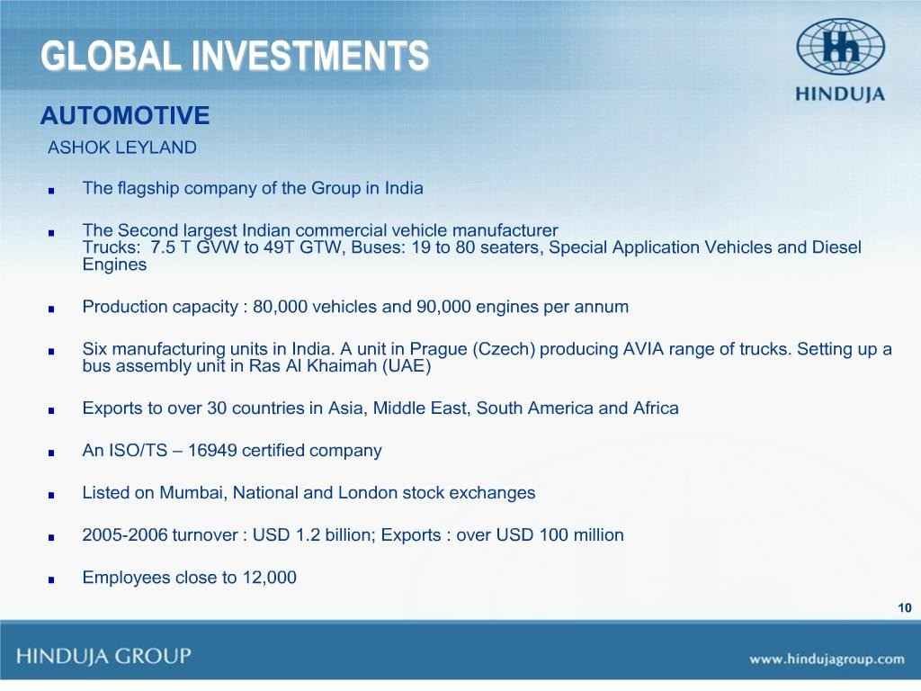


Slide 11
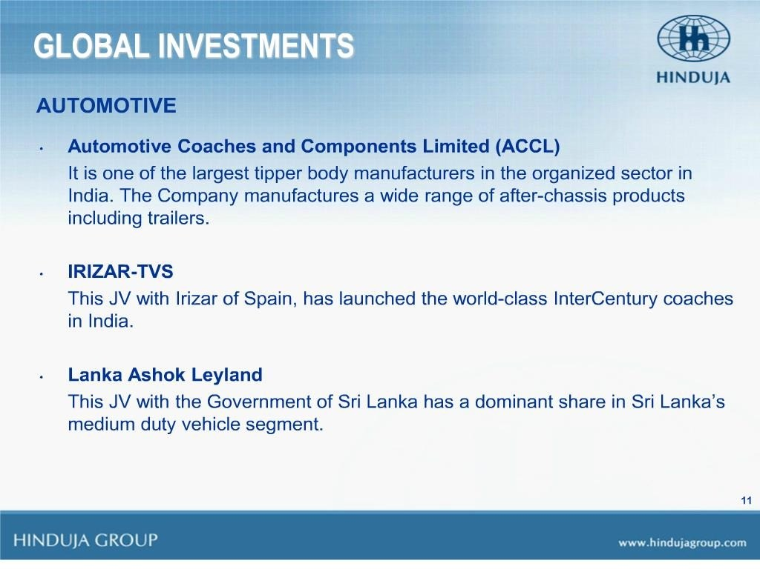

Slide 12
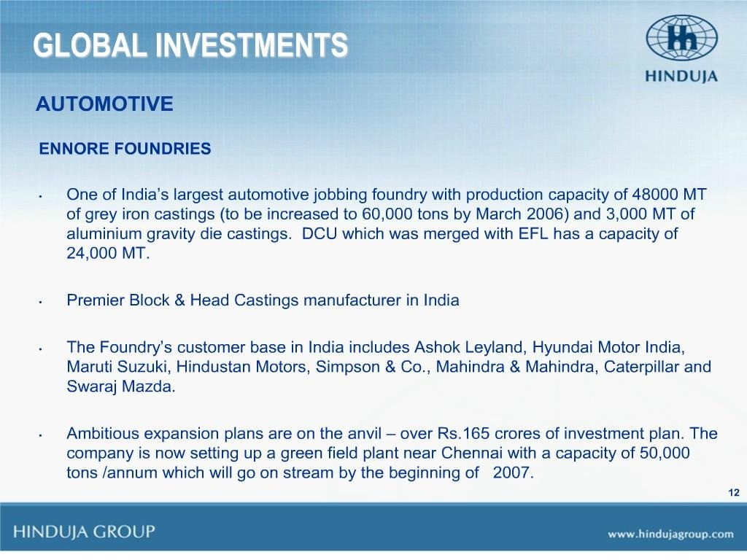

Slide 13
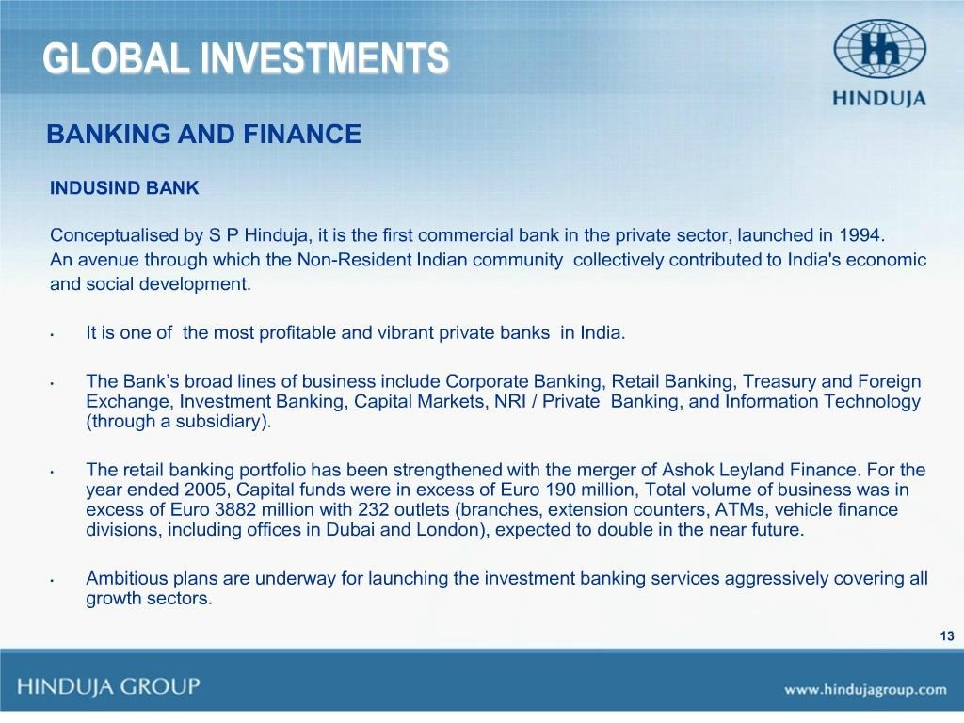

Slide 14
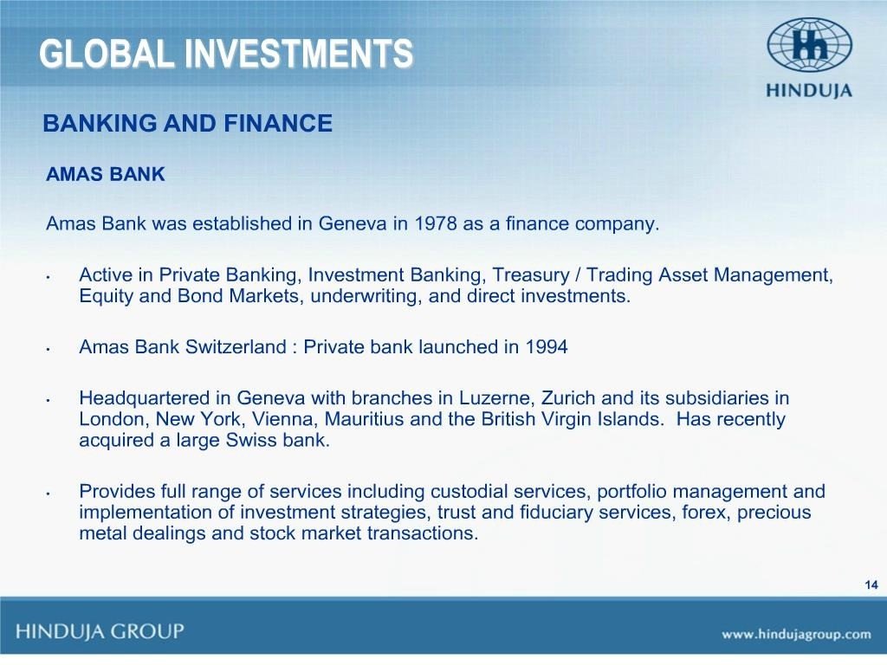

Slide 15
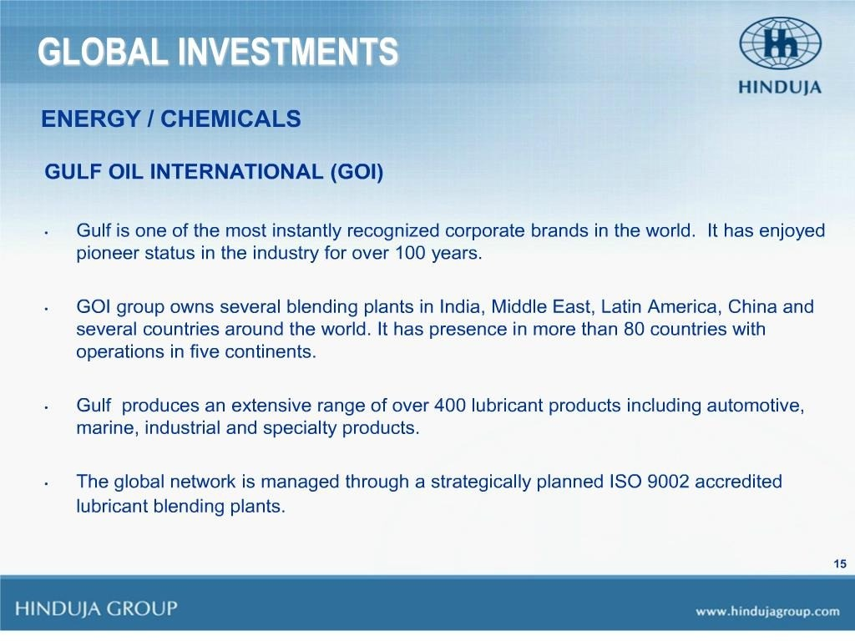

Slide 16
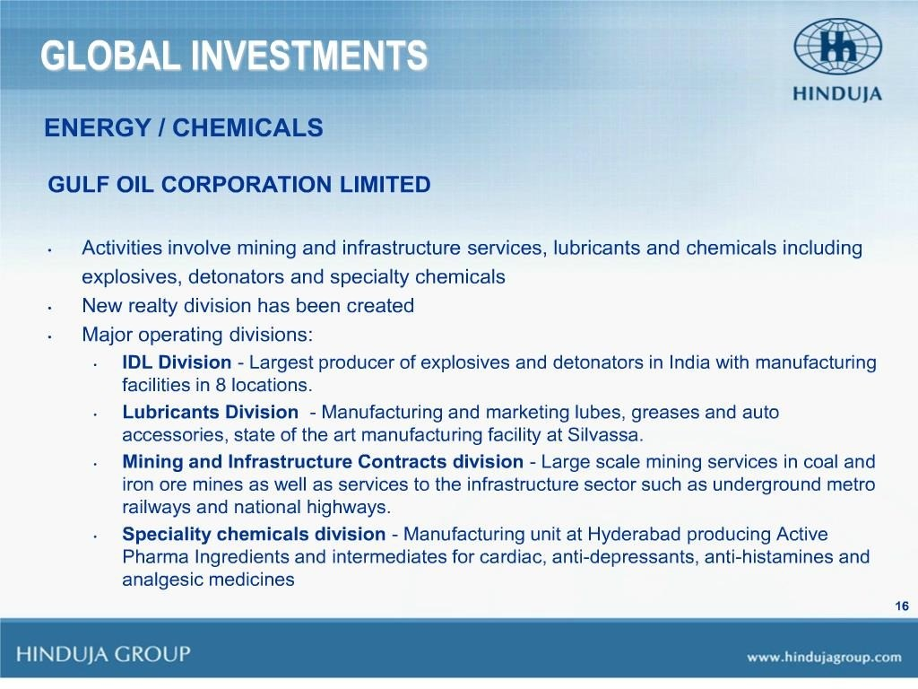

Slide 17
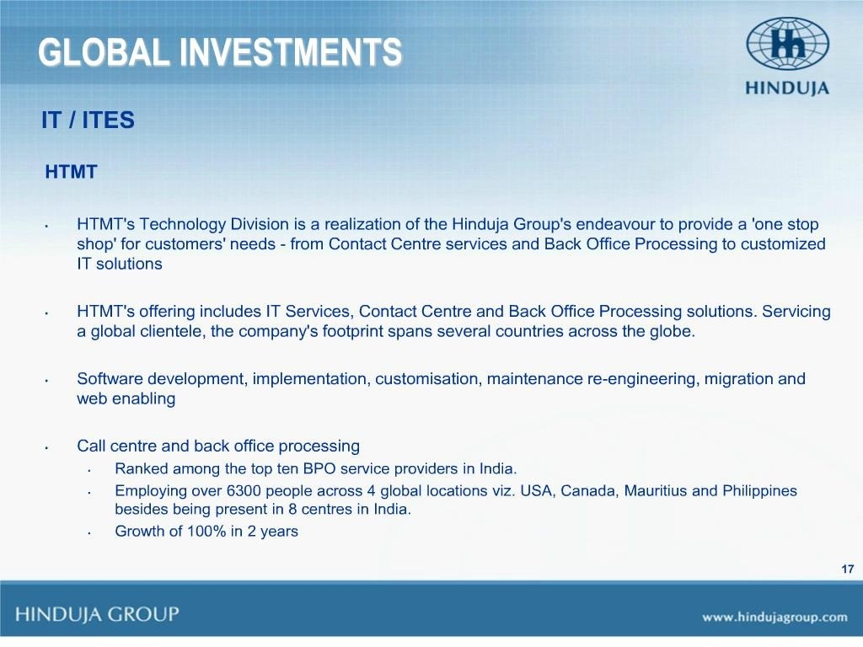

Slide 18
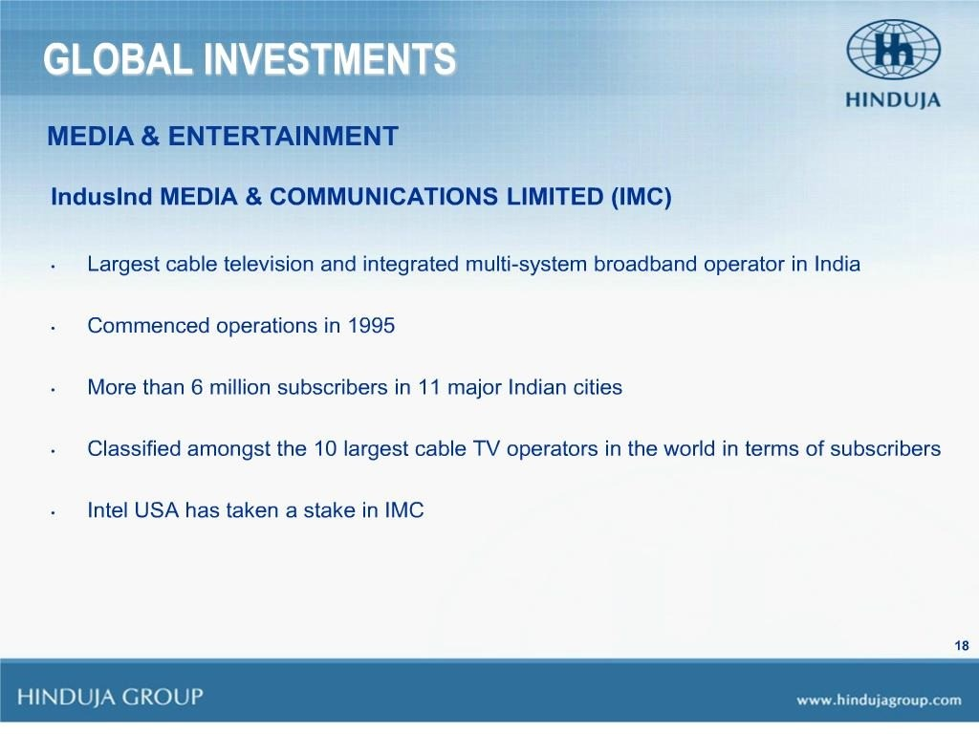

Slide 19
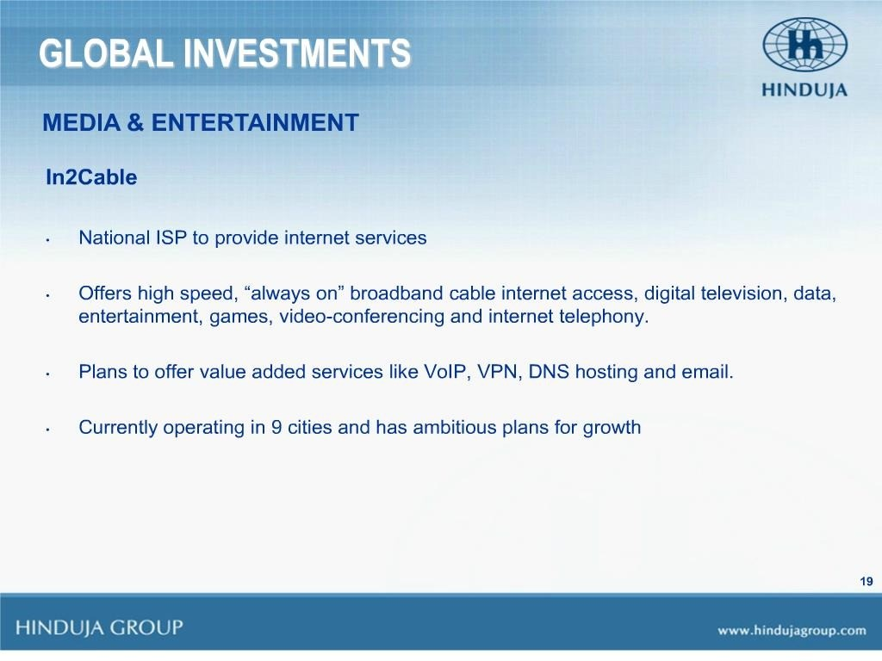

Slide 20
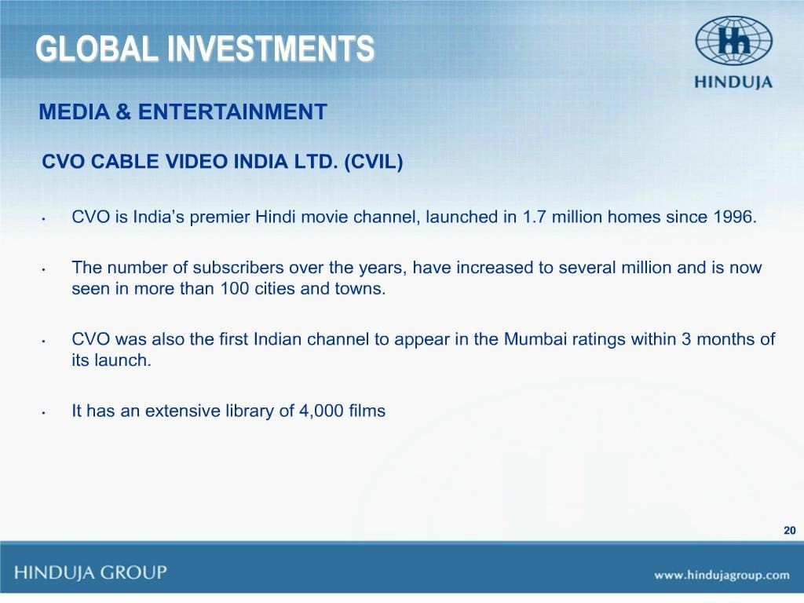

Slide 21
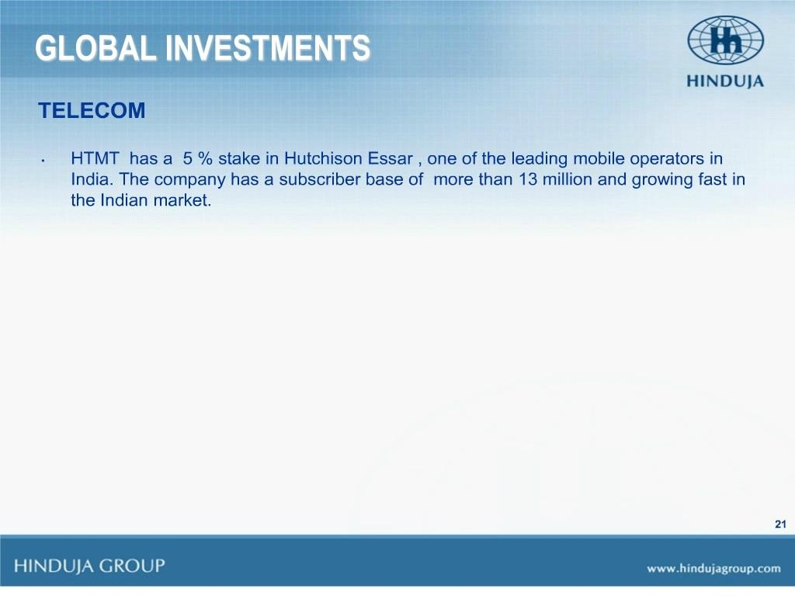

Slide 22


Slide 23
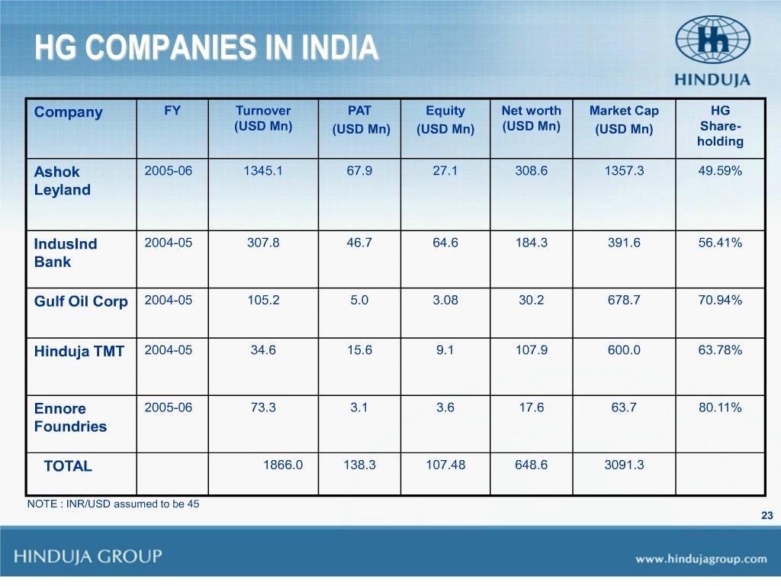

Slide 24


Slide 25


Slide 26
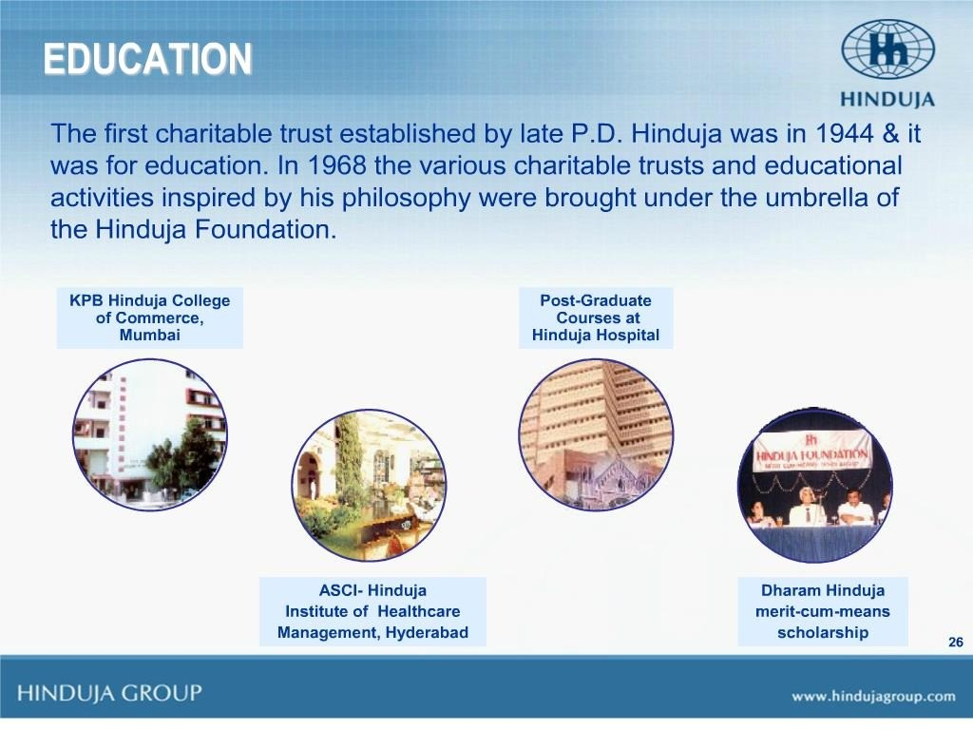

Slide 27
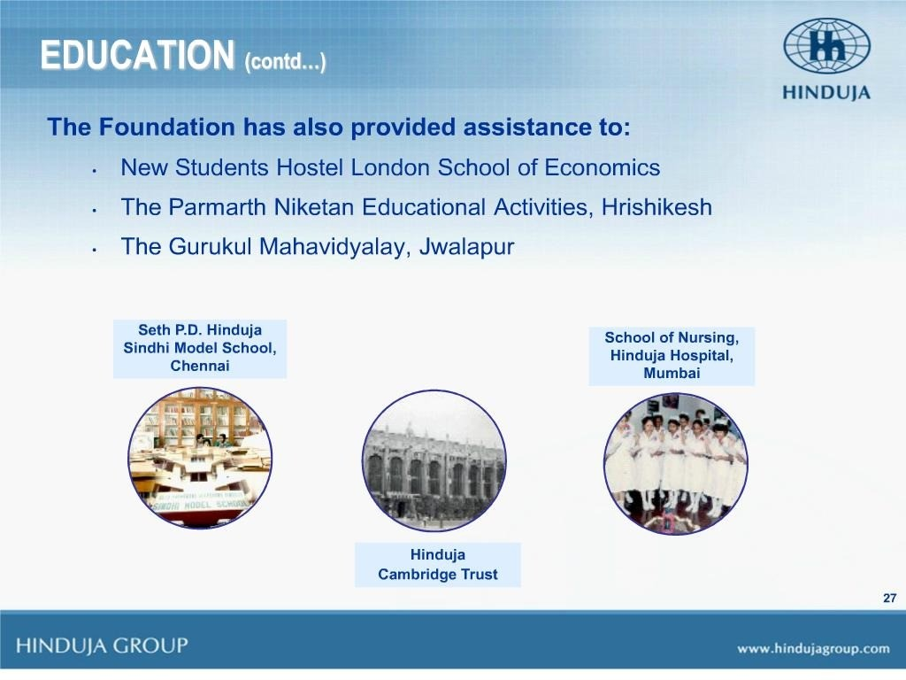

Slide 28


Slide 29


Slide 30


Slide 31


